Slide 1

University of Gondar Collage of Informatics Department of Information System Final Year project on
Ride Management Application for Bajaj’s in
Gondar City
Prepared by:
Name ID Number
Assefa Demses 00737/12
Dereje Aragaw 02236/12
Fikir Getu 01627/12
Firaol Teklu 01156/12
Henok Gashew 01181/12

Slide 2

Content overview
Introduction
Statement of the problem
Objectives
Scope and limitation
Methodology
Significance
Requirement Analysis
Use case diagram
Activity diagram
Sequence diagram
Class diagram
Component diagram
Deployment diagram
SW architecture

Slide 3
Introduction
Transportation is the movement of people and goods from one location to another.
The transportation industry in Ethiopia has undergone significant changes with the rise of meter taxis and ride-hailing services.
Gondar City is an urban center in Ethiopia with a high demand for transportation services.
in Gondar, growth of ride-hailing services is very slow.
a city that is a destination for tourists and tourism is slow on current trends
Notes:
As human transportation is one of the core activities of our life.

Slide 4
Statement of the problem
Some problems with the existing structure are listed as follows:
Already existing systems like Zayride or Zoble Ride are inapplicable of for a city like Gondar
Low availability and security of Bajaj transport
The inconsistent and variable cost of a private contract driver Bajaj

Slide 5
Justification
Development of a new ride-hailing platform that specifically caters to the transportation needs of Gondar city by offering a low-cost, on-demand, and reliable transportation option
To ensure the safety and security of our riders, all drivers by working closely with local law enforcement agencies to address any security concerns
provide them with a steady stream of customers and help them improve their earnings

Slide 6
Objectives
General Objective: develop a low-cost, secure, and accessible transportation service for Gondar City using Bajaj.
Specific Objective
Collect data, analyze, design system requirements and identify problems
Design an easy-to-use and responsive user interface
make the pricing competitive and have incentives for customer retention
Evaluate the system
Notes:
General: the overall goal of project
Specific: smaller actionable goals that lead to fulfilling the general objective

Slide 7
Scope
Project aims to develop a ride-hailing iOS and Android platforms app that offers a convenient and efficient mode of transportation for users.
The scope of the project mainly focuses on
User Registration
Ride Booking
Driver Matching
Ride Tracking

Slide 8
Limitation
Main limitations of the system are
No electronic payment processing system
Doesn’t have an Amharic language interface
The system doesn’t have accessibility options for visually challenged users

Slide 9
Methodology
chosen development methodology for its adaptiveness is Rapid Application Development(RAD). Why?
Allows to move back and forward between design phases.
Easy to make improvements to the design and implementation
Important issues addressed before final system delivery
Disadvantage
Requires clients and developers to be in active collaboration

Slide 10
Significance
For Bajaj drivers:
Solve the availability problem of passengers
Provide places where their services are required
Ensure their security
For passengers:
Make bajaj readily available when the need arises
Ensure their security
Removes the need to stand by the side of the road and wait for Bajaj

Slide 11
Requirement Analysis
Functional Requirements
User registration and login
Driver and passenger verification
Ride booking and requesting
Real-time tracking of drivers and passengers
Driver and passenger ratings and reviews
Customizable settings for users, such as payment view and ride preferences.
Database management for the administrator
Calculating trip cost
Notes:
Functional Requirements: a set of specifications that define what a system or product should do.

Slide 12
Requirement Analysis
Nonfunctional Requirements: a requirement that specifies criteria that can be used to judge the operation of a system.
Reliability
Availability
Scalability
Performance
Usability
Security
Notes:
nonfunctional Requirements:

Slide 13
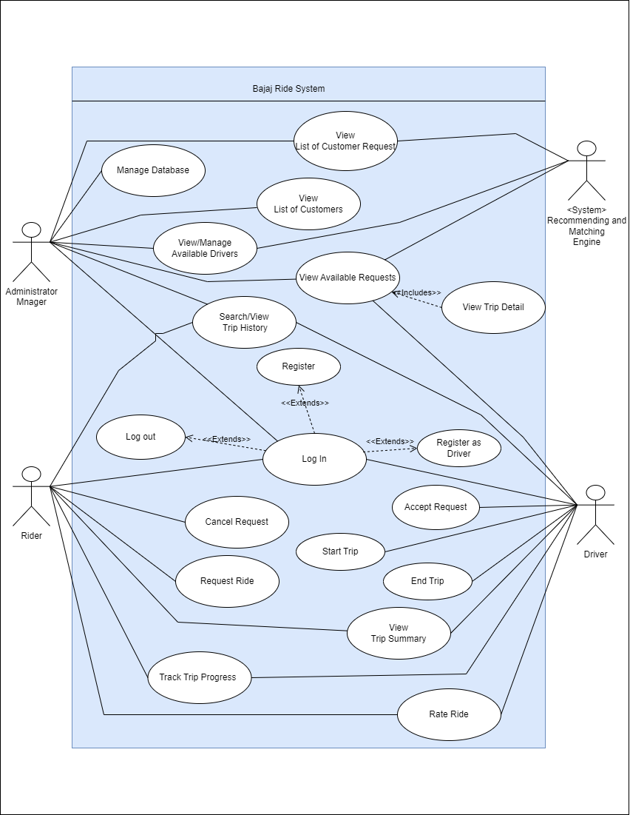
Use case diagram
Use Case ID | UC_001
Use Case Name | Login
Actor | Rider, Driver
Description: | Users can log in to their account with their registered phone number and OTP password to access the Bajaj Ride app.
precondition | The user must have a registered account with Bajaj Ride.
Postcondition | The user is logged in and has access to the app's features.
Main Flow | User action | System response
 | →User opens the Bajaj ride app. → User enters their registered phone number ← user enters given OTP as password | ← System sends OTP to the entered phone number. ← System verifies password and logs the user into their account and displays the app's home screen.
Alternative Flows | If the user enters an incorrect password, the system will display an error message and prompt the user to try again. If the user enters an unregistered phone number, the system will take the user to the account setup interface.
Notes:
describe the high-level functions and scope of a system. These diagrams also identify the interactions between the system and its actors.

Slide 14
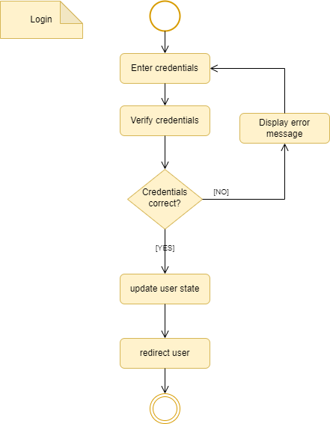
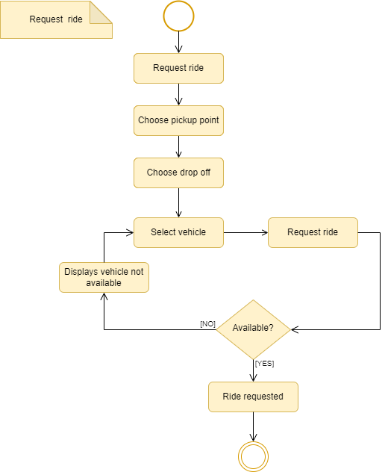
Activity diagram
Activity Diagram for a ride request
Activity Diagram for Log in
Notes:
shows the flow from one activity to another in a system or process

Slide 15
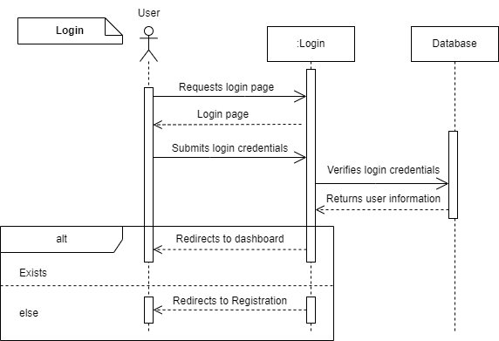
Sequence diagram
Notes:
to show the interactions between objects in the sequential order that those interactions occur

Slide 16
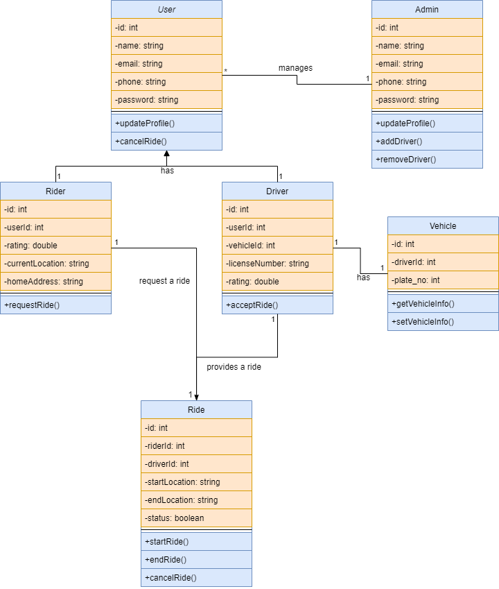
Class diagram
Notes:
purpose is to provide a high-level view of the structure of a system or application that can help stakeholders to understand the components of the system and how they are related to each other.

Slide 17
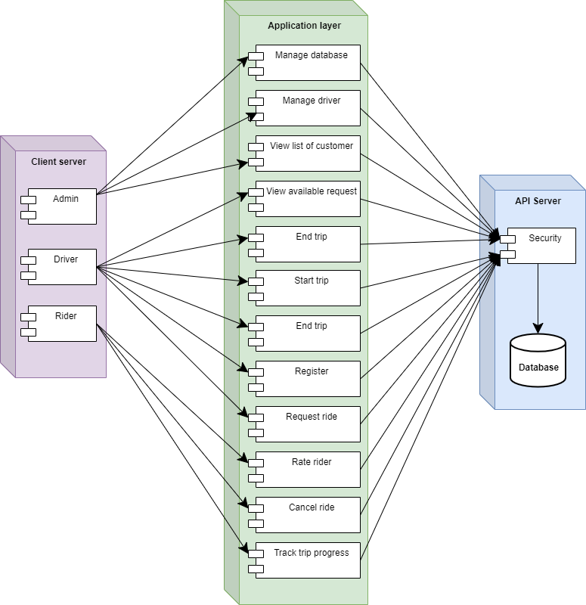
Deployment diagram
Notes:
lets visually represent all system's components, the interactions between them and relationships with external user interface.

Slide 18
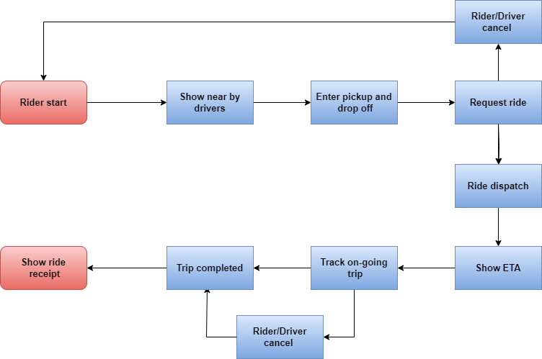
SW architecture

Slide 19
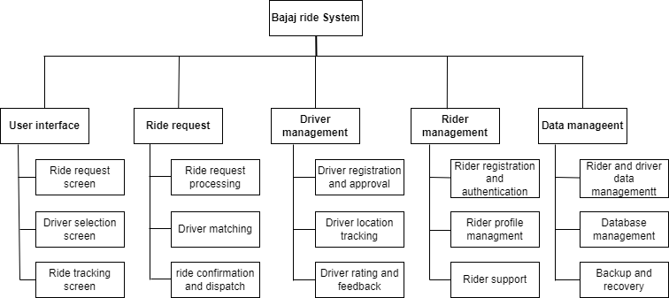
Decomposition diagram
Notes:
shows a complex, process, organization, data subject area, or other type of object broken down into lower level, more detailed components

Slide 20

Any question Is Welcome
Thank You

